Slide 1
East Midlands Railway TALK Cards
12/09/23
Hannah Cotton-Diederich
Access and Inclusion Manager

Slide 2
The Challenges
1 in 5 people identify as having a disability in the UK and it is estimated that 80% of these people have a non-visible disability.
East Midlands Railway received feedback from customers on how having a non-visible disability can negatively impact train travel experiences, and they experience disregard or disbelief of their disability.
People with non-visible disabilities may need more time to communicate, require additional care and assistance. Some people are non-verbal and need support to find services or ask questions.
EMR identified that by improving awareness and understanding of non-visible disabilities it will help to reduce stigma and exclusionary practices, and support self-identification and disclosure of non-visible disabilities.

Slide 3
The Ambition
After talking with the Aphasia UK charity (which is a charity who help people all over the UK with neurological support) about an experience a member had when travelling by train, EMR connected with the Royal College of Speech and Language.
As a result of positive collaboration, EMR is working with the Royal College of Speech and Language to achieve the Communication Access Accreditation, this will result in EMR being a business which shows commitment to creating accessible communication environments and services for people with communication disabilities.
The T-A-L-K card was designed from the communication principals detailed in the Communication Access eLearning modules. The ambition was to create a tool which would be a positive and cost-effective solution to ease the difficulties that some customers experience when travelling by rail.

Slide 4
The Planning
Recognising that staff need a quick reference tool to achieve better communication outcomes with staff.
Recognising that EMR can support customers better when travelling providing a simple and supportive experience for customers.
Engaging with On-Train and Station Managers to issue staff TALK Cards.
Providing hub stations with a supply of TALK Cards to give to customers.
Creating a request process on the EMR website for customers to request a TALK Card.
Creating a communication plan to tell customers about the TALK Cards.

Slide 5
The TALK Card
A list of all the available TALK cards are on the EMR website, and can be requested by submitting a request either, on the website, by emailing EMR at contact@eastmidlandsrailway.co.uk by phone (03457125678), or by sending a message on WhatsApp 07501330988, cards will be posted out to customers or can be collected at staffed stations. EMR are also considering the feasibility of making a version of the TALK Card available as a downloadable version on the EMR website, customers will be able to print at home or use these digitally.
The TALK cards are being briefed to all EMR frontline teams in conjunction with the current disability awareness training. Information on TALK cards will be shared with other train operators.
There are 9 cards in total ranging from, please help me buy a ticket, can you tell me where the toilets are and please be patient if I am confused.

Slide 6
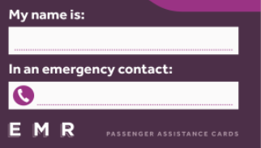
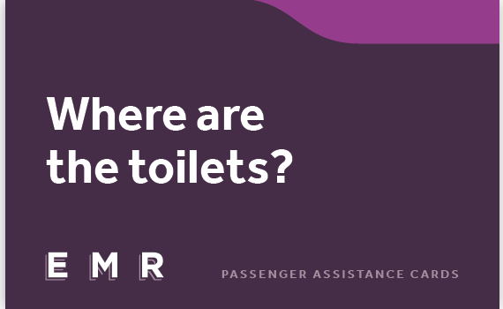
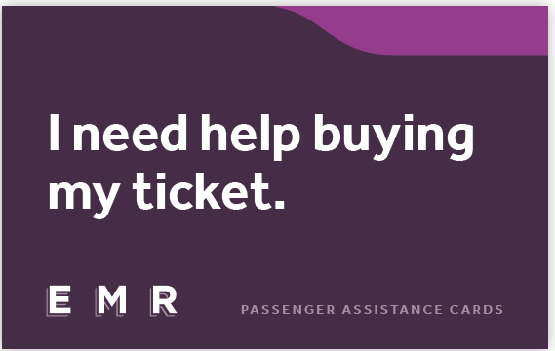
TALK Card Examples

Slide 7
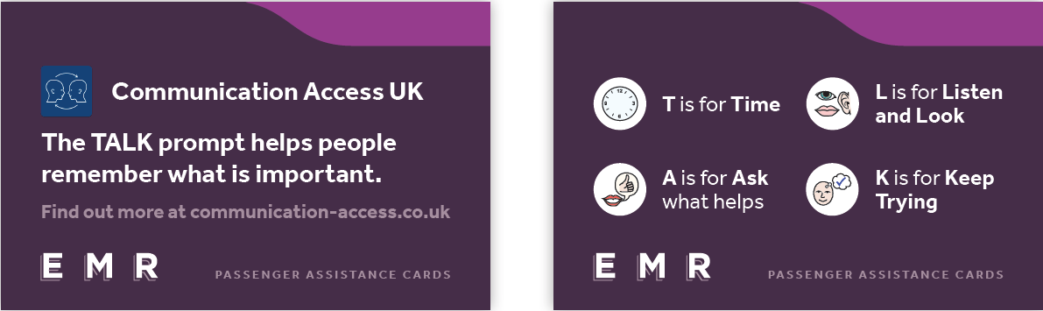
The Staff TALK Card

Slide 8
Customer Panel Feedback
A Great idea, looking forward to seeing what they’re like
A Love the talk cards
A Talk cards sound fantastic
A This will really help me when I am at a station

Slide 9
Contact
hannah.cotton-diederich@eastmidlandsrailway.co.uk
Access and Inclusion Manager
East Midlands Railway

